Slide 1



For Eagle Scout Candidates,
Unit Leaders and Parents/Guardians
10/2023 Life
to Eagle
Iron Hill District
Del-Mar-Va Council
District Advancement Committee (DAC)
Kristina Breidenbach - Advancement Chair
Dan White - Eagle Board Chair
This document is for reference only and subject to change. Review the most updated documents on the official BSA websites for current information.
Notes:
Presenter note: You should include your name and position. Explain your responsibilities and authority in your troop’s Eagle process.

Slide 2
Today’s Objectives
Eagle Feathers
Eagle Scout Rank Requirements
Eagle Scout Service Project
Eagle Scout Rank Application
Notes:
Presenter notes:
Set the tone for the seminar and put both parents & Scouts at ease.
Remind them that the process & procedures for the Eagle is different from the lower ranks because the district, council, and national BSA have approval requirements.
Note that in the past there may have been problems because everyone did not understand the process and some pitfalls so that is the reason for this seminar – to avoid any surprises.
Note that the troop wants all Scouts to be successful and if they want to earn the Eagle rank, you will help them. Also point out that it is ultimately the Scout’s responsibility (not his parents or the troop leaders) to have a plan for how he will meet all the requirements them follow through to reach his goal. The Scout gets to wear the Eagle rank for the rest of his life, therefore he should be the one to earn it.

Slide 3

Eagle Feathers
The Rank of Eagle tells others about OUR:
  Character
  Skill
  Leadership ability
The Rank of Eagle is held by only 2-4% of all Scouts
The Rank of Eagle is time limited - Beware the 4 G’s
  Grades – Gas – Games – Girls/Guys … Plus Jobs and Sports
The Eagle rank is also a serious consideration for college entrance accomplishments and military recruiters.

Slide 4
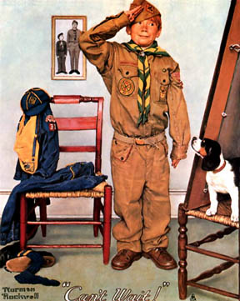
Requirement 1. Participation
Be active in your troop, team, crew, or ship for a period of at least six months after you have achieved the rank of Life Scout.
Mastery of Scouting skills & personal character growth cannot happen without participation.
Participation goals may vary from unit to unit.

Slide 5

Requirement 2. Scout Spirit
Demonstrate that you live by the principles of the Scout Oath and Scout Law in your daily life. List the names of individuals who know you personally and would be willing to provide a recommendation on your behalf including parents/guardians, religious, educational, and employer references.
Scouting ideals are reflected in the character of an Eagle.
He or she sets the example, not only in the
Scouting setting, but in every facet of their
life.

Slide 6
Req. 2. Scout Spirit Cont. - References
The Board of Review requests reference letters to be provided by the unit leader with the Eagle Application.
Per Delmava Council policy - the Scout should supply their list of references to their Scoutmaster or Advancement Chair at a minimum of 4 weeks prior to his Eagle SMC. The Scout should notify potential references of the pending request. The SM and/or AC are to make the requests and receive the reference letters. A Scout should not receive the letters directly. Although the Scout may assist with any contacts that do not respond, it is the responsibility of the unit to follow-up, not the Scout’s

Slide 7
Req. 2. Scout Spirit Cont. - References
Each list of references should include the following:
  1) Parents
  2) Religious reference - Priest, minister, pastor, Rabi, imam, or other religious leader. If the Scout is not affiliated with religious organization a special reference from someone that knows the Scouts religious background maybe used. A Parent may supply this reference as well.
  3) One or more letters from teachers, coaches, school administrators, employers, neighbors, family, friends etc.
  4) Employer if the Scout has a part time job.

Slide 8

Requirement 3. Skills
Earn a total of 21 merit badges (14 required badges).
List the month, day, & year the merit badge was earned.
The Merit Badge Program promotes:
  Basic character-developing tools
  Opportunity to learn career skills
  Develop physical fitness…
  and hobbies and interests for a lifetime
  Contact with adults with whom you may not be acquainted
All requirements must be completed prior to 18th b-day
Eagle application dates must match Council Records

Slide 9
Requirement 4. Leadership
While a Life Scout, serve actively for a period of six months in one or more of the following positions of responsibility.
May be elected by peers or assigned by the Scoutmaster
6 Months is the MINIMUM, more than one position may be held
On the Eagle Application list only positions held while a Life Scout
Serve Actively means: Must do the job - Not just wear the patch
Approved troop positions are: (Venturing Crew- Check latest Eagle Scout Application)
Senior Patrol Leader Troop Scribe Patrol Leader Instructor
Asst. Senior Patrol Leader Troop Librarian Chaplain aide OA Rep
Jr Asst. Scoutmaster Troop Historian Den Chief Troop Guide Outdoor Ethics Guide Webmaster Troop Quartermaster
The Scoutmaster may assign a special leadership project in place of a Position of Responsibility - for Star and Life, NOT for Eagle.

Slide 10
Requirement 5. ESSP
While a Life Scout, plan, develop, and give leadership to others in a service project helpful to any religious institution, any school, or your community. (The project must benefit an organization other than the BSA.) A project proposal must
be approved by the organization benefiting from the effort, your unit leader and unit committee, and the council or district before you start. You must use the Eagle Scout Workbook 2023a – 2/23, in meeting this requirement. (To learn more about the Eagle Scout service project, see the Guide to Advancement, section 9)
Demonstrating PLANNING & LEADERSHIP, through service, is still the objective.
The Scout: Plans, Develops, and Leads others….
The Unit: Provides mentorship so that the Scout can do his very best at planning and executing this requirement.
The District: Reviews the ESSP Proposal for Community Benefit, Leadership Opportunity commensurate with the rank of Eagle Scout, and the candidate’s understanding of further planning. And approves the proposal when it is ready.
All of the Scouting methods, training, experience, and YOUR skill are being “tested” by this requirement.

Slide 11
Eagle Scout Service Project
Cannot be routine labor or benefit a commercial business and have an opportunity for Planning, Development and Leadership.
Must benefit religious institute, any school, charity, or your community. NOT BSA
May NOT be a “fund raiser”
  Fund-raising is permitted only for securing materials needed to carry out the project.
  Donors to projects must be made aware of what entity is benefiting from the project, and that it clearly is not the Boy Scouts of America.
  Any funds raised for a project and not used for the purchase of project materials must go to the beneficiary.
  A Scout is thrifty… they help to pay their own way
Must be planned and carried out by one Scout - no joint projects
Can take 3-12 months to complete - plan ahead! A key lesson most candidates learn is that they can’t control other people’s schedules
Must take place while a Life Scout

Slide 12


ESSP - Overall Process
Generate 2-3 possible ideas (internet, previous projects, leaders, interest or passion of Scout, religious organization, troop sponsor)
Discuss ideas with your Unit Leader, Coach, Mentor, and Beneficiary Rep
  Consider Leadership Opportunity, Community Value and Project Scope
  Obtain initial approval from Unit Leadership & Beneficiary
Put together a project PROPOSAL
  Detail planning is not necessary prior to approval
  Must use most recent official ESSP Workbook (2023 latest) (available on-line for Apple & Windows OS, not compatible with Chromebook OS). Use of older workbooks will be returned for resubmittal with up-to-date workbook
Obtain Approvals: THE CANDIDATE SIGNS THEIR COMMITMENT
  1) Unit Leader, 2) Unit Committee, 3) Beneficiary
  4) District Advancement Committee (email to: 70Eagle279@gmail.com)
Develop the detail plan
Submit to approvers for review (not additional approval)
Execute the Plan when the unit agrees the plan is ready
Record Changes & Complete ESSP Workbook

Slide 13
ESSP – *Beneficiary approval!!!
Prior to selecting your project make sure to find a beneficiary you can work with and will provide the guidance you will need on what they are looking for.
Make sure the person you are working with can make decisions on the behalf of the beneficiary organization. You cannot begin work until the beneficiary signs off on your project.
Communication with the beneficiary should be maintained at all times to make sure your work and the beneficiary’s visions are aligned. Also make sure that you avoid ”project creep”. Stick to the approved plan. If the beneficiary requests additional work it must be in the scope of the project.
If your project deviates significantly from your plan
you will need to consult the Eagle Project committee.

Slide 14
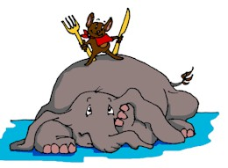
ESSP - Writing the
Proposal - Overview
X
X
First step in Project
Use the February 2023 (or most current version) ESSPW #2023a - Instructions are on Page 3-4 (Read the entire workbook)
Must show:
  Provides sufficient opportunity to meet the Eagle Scout service project requirements. (Planning, development and leadership opportunity)
  It appears to be feasible (Realistic but challenging for the rank of Eagle)
  Safety issues are considered. (Possible safety concerns and guard against injury and what to do if someone gets hurt – Guide for Safe Scouting!)
  Key phases and steps required to complete final detailed plan
  Action steps for further detailed planning are included.
  You are on the right track with a reasonable chance for a positive experience and can meet your timeframe
  NO work can be done on the project, fundraising or donations until the project is approved!!!
Be Prepared and Time Management are critical

Slide 15
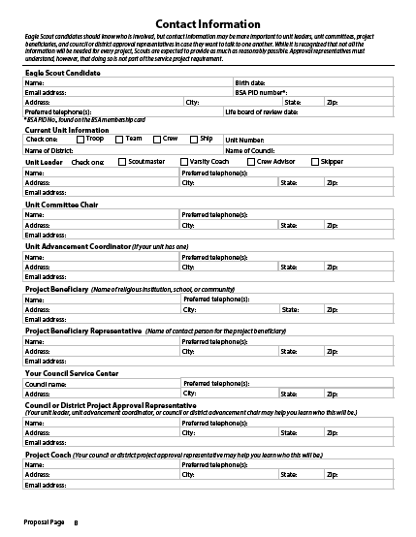
ESSP – Contact Page
Proposal page B
Contact Information
  This needs to be completely filled out – Just like a job application
  If not applicable – write N/A
  District will not review proposal if this page is incomplete.
  Council Contact is: Carol Swank, Delmarva Council, 1910 Baden Powell Way, Dover DE 19904 (Not the old Scout Store in Wilm.)

Slide 16
ESSP – Project Description
  Project Description and Benefit (MOST IMPORTANT to get this right)
  Succinct description of project goal(s) and scope.
  Mention sizes, numbers, general process, etc. to help define the scope of the project.
  Explain the true benefit, include a description of the current condition.
  How long will it take and how many people will you lead?
Drawings, Photos, Google view and documents (a must for any area planning)
  These are included as extra documents with the proposal document. They will not be embedded into the workbook.
  Include a caption that explains the photo or drawing
  Include photos of current condition or where the new item will be located.
  Give credit to drawings or plans created by others.
Check grammar and spelling – this is the capstone of your Scouting journey, do your best!
X
X

Slide 17
ESSP–Establish the Vision
Project Description Example
  My project is going to be located at the picnic and ceremony area at Christ the Teacher Catholic School. I will be creating a memorial area to remember parents, students and teachers from the school community who have passed away. To do this I will be putting in a flag pole and a memorial stone next to the flag pole that will have a plaque on it listing the names of the departed loved ones from our family at Christ the Teacher School. I will also be naming the 1/2 mile walking trail located in the woods right next to the ceremony area. The trail will be called the "Trail of Angels." Along the trail I will have a total of 11 plaques that will contain bible verses. The plaques will be spaced about 240 feet apart and the bible verses will contain positive messages about life after death and eternal salvation with Jesus. I also plan to improve the appearance of the ceremony area by installing new bases to the wood benches, building a storage structure for the firewood and adding a new layer of mulch.

Slide 18
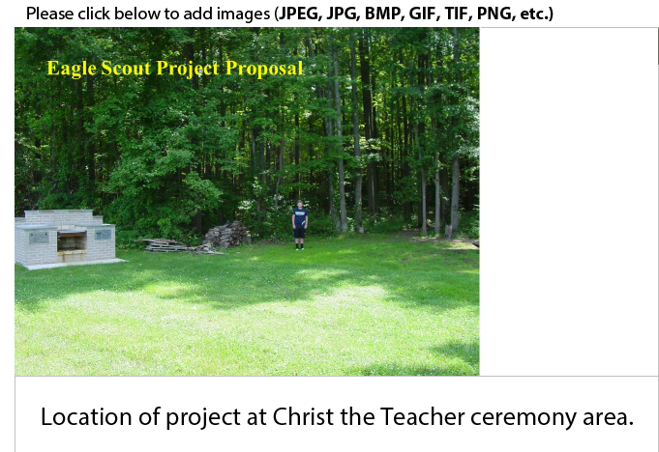
ESSP–Establish the Vision

Slide 19
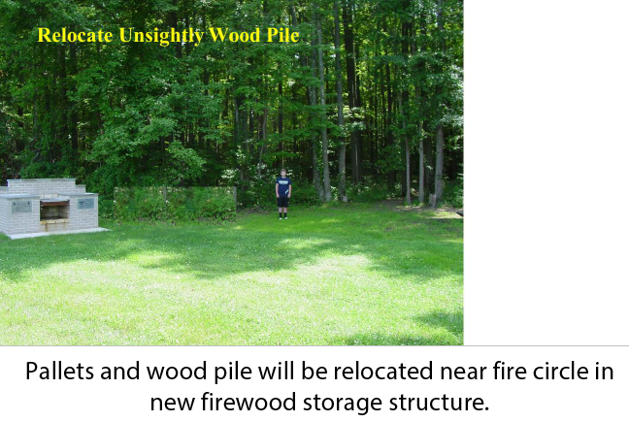
ESSP–Establish the Vision

Slide 20
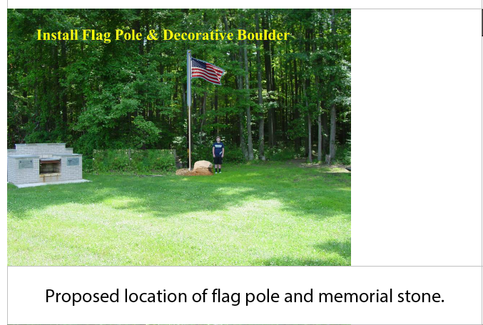
ESSP–Establish the Vision

Slide 21
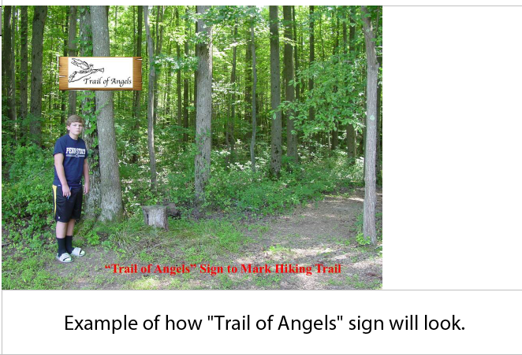
ESSP–Establish the Vision

Slide 22
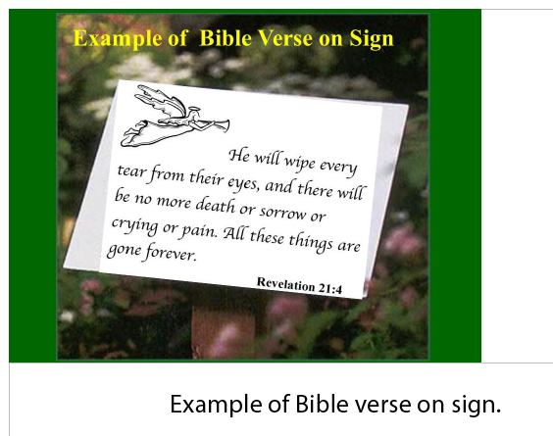
ESSP–Establish the Vision

Slide 23
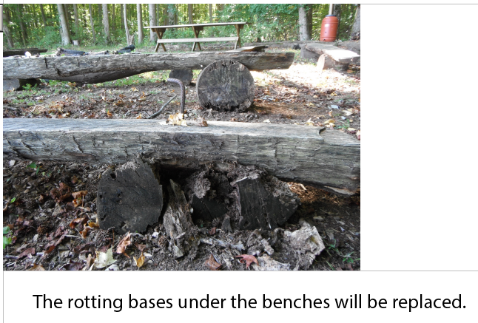
ESSP–Establish the Vision

Slide 24
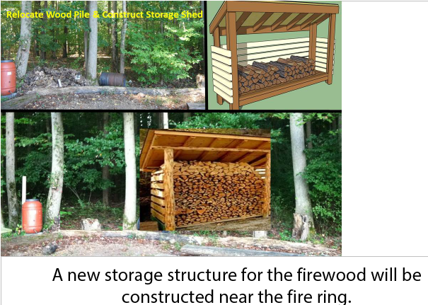
ESSP–Establish the Vision

Slide 25
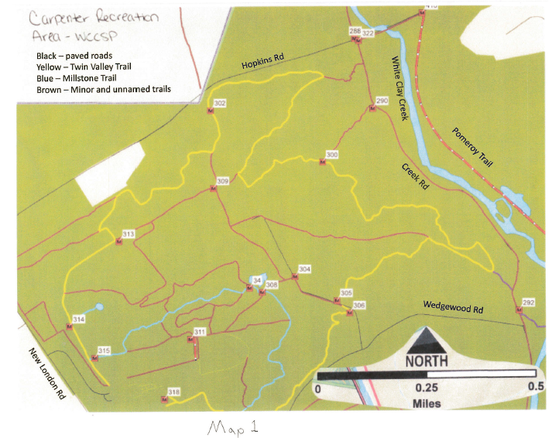
ESSP–Establish the Vision
Examples of other drawings, plans and photos
Example of Map showing locations of 17 new trail markers

Slide 26
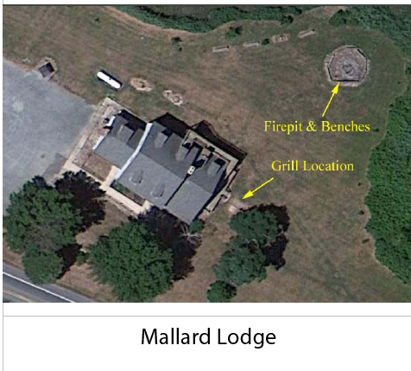
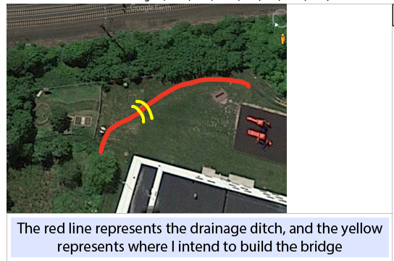
ESSP–Establish the Vision
Examples of other drawings, plans and photos
Examples of Aerial Drawing showing project location

Slide 27
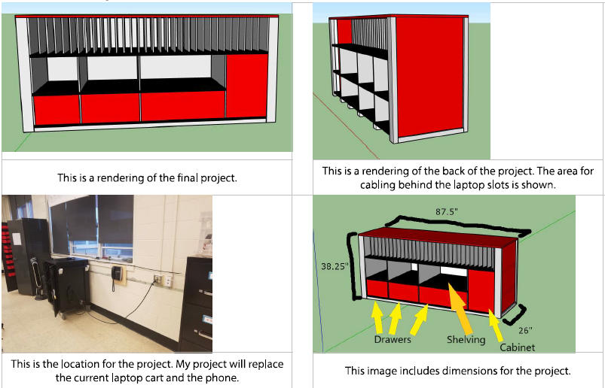
ESSP–Establish the Vision
Examples of other drawings, plans and photos
Example of drawings and location of a laptop cabinet

Slide 28
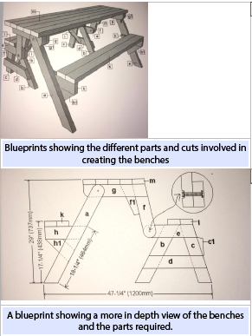
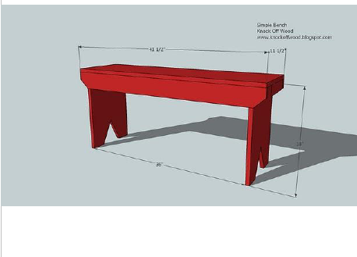
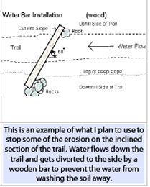
ESSP–Establish the Vision
Examples of other drawings, plans and photos
This is what the bench will look like
Example of design drawings

Slide 29
ESSP – Materials,
Supplies and Tools
X
X
Materials (Stuff used and left behind)
Supplies (Stuff used up)
Tools (Equipment used to complete the project)
All three lists should
These are general lists of items needed to meet the project goals
Be as thorough as you can, does not have to be 100% complete but must show good thought
Does not require detail research for material quantities.
Lists should coincide with safety issues (ie. Dehydration, include water, Power tools, include eye, ear, lung and hand)

Slide 30
ESSP – Permits, Cost and funding project
Permits and Permissions
  Some projects will require permission beyond that which the beneficiary provides such as building permits or Miss Utility. Indicate these and be sure to allow plenty of extra time to obtain these.
Preliminary Cost Estimates
  Will need to do some research to estimate the cost of Materials, Supplies, Tools, and miscellaneous. Do not just make guesses! NOTE: Lumber and many building supplies have gone up significantly over the last several years! Also, some supplies may be in short supply!!! Seek out contractors for used or surplus materials!
  Should only be considered for things that will be consumed by the project (don’t estimate costs for tools you will borrow).
Fund Raising
  Explain with some details how you plan to raise the money for the project.
  Think of fundraisers that have leadership opportunities.
  The fundraising is part of the approved project and if included is expected to be completed.
  Remember that a Scout is Thrifty
X
X

Slide 31
ESSP – Phases and
Logistics
X
X
Project Phases
  These are the major steps you will make in completing your entire project from start to finish. Some phases could include:
    Complete the final detailed plan
    Submit the fundraiser application – (have a plan to make the fundraiser successful!)
    Fundraiser
    Purchase and deliver materials
    Contact Miss Utility
    Complete the fundraiser and project
    Complete the project workbook
    Send thank you’s to those that made my project a success
Logistics
  Simply stated, this section explains the plan for how all the project resources will be moved and possibly stored during your project. Other logistics could be the removal of dirt, grass or branches, or the location of nearest bathrooms or electricity.

Slide 32
ESSP – Safety and
Further Planning
X
X
Safety Issues
  List as many potential safety hazards and concerns as you can think of in this section. You do not have to show how you will prevent or deal with those issues in the proposal. (Include required items in the Tools, Supplies and Materials sections). Some examples are: Dehydration, Splinters, Hitting fingers with hammers, Puncture wounds, Lacerations, Poisonous plants, electrocution, debris in eyes, loud noise, blisters, Covid 19 issues, etc.. Make sure to check and reference The Guide for Safe Scouting to make sure that jobs and equipment are age appropriate!
Further Planning
  These are the steps you plan to take in completing your detail plan - NOT the steps needed to execute the plan.
  Examples: Investigate the best paint for cement blocks outdoors, create a detailed materials list, detailed drawings, determine the best flowers or grass for the area with full sunlight, etc….

Slide 33
ESSP – Signatures
X
X
Signatures
  The candidate signs their commitment (read before you Sign).
    Confirms that he or she have read the entire ESSPW
    They will lead the project
    They will do their BEST to carry it out for MAXIMUM benefit to the religious institution, school or community they choose as the beneficiary
  Unit Leader
  Unit Committee
  Beneficiary – Also confirms that they received a copy of “Navigating the Eagle Scout Service Project, Information for Project Beneficiaries”
  Lastly → Iron Hill District

Slide 34
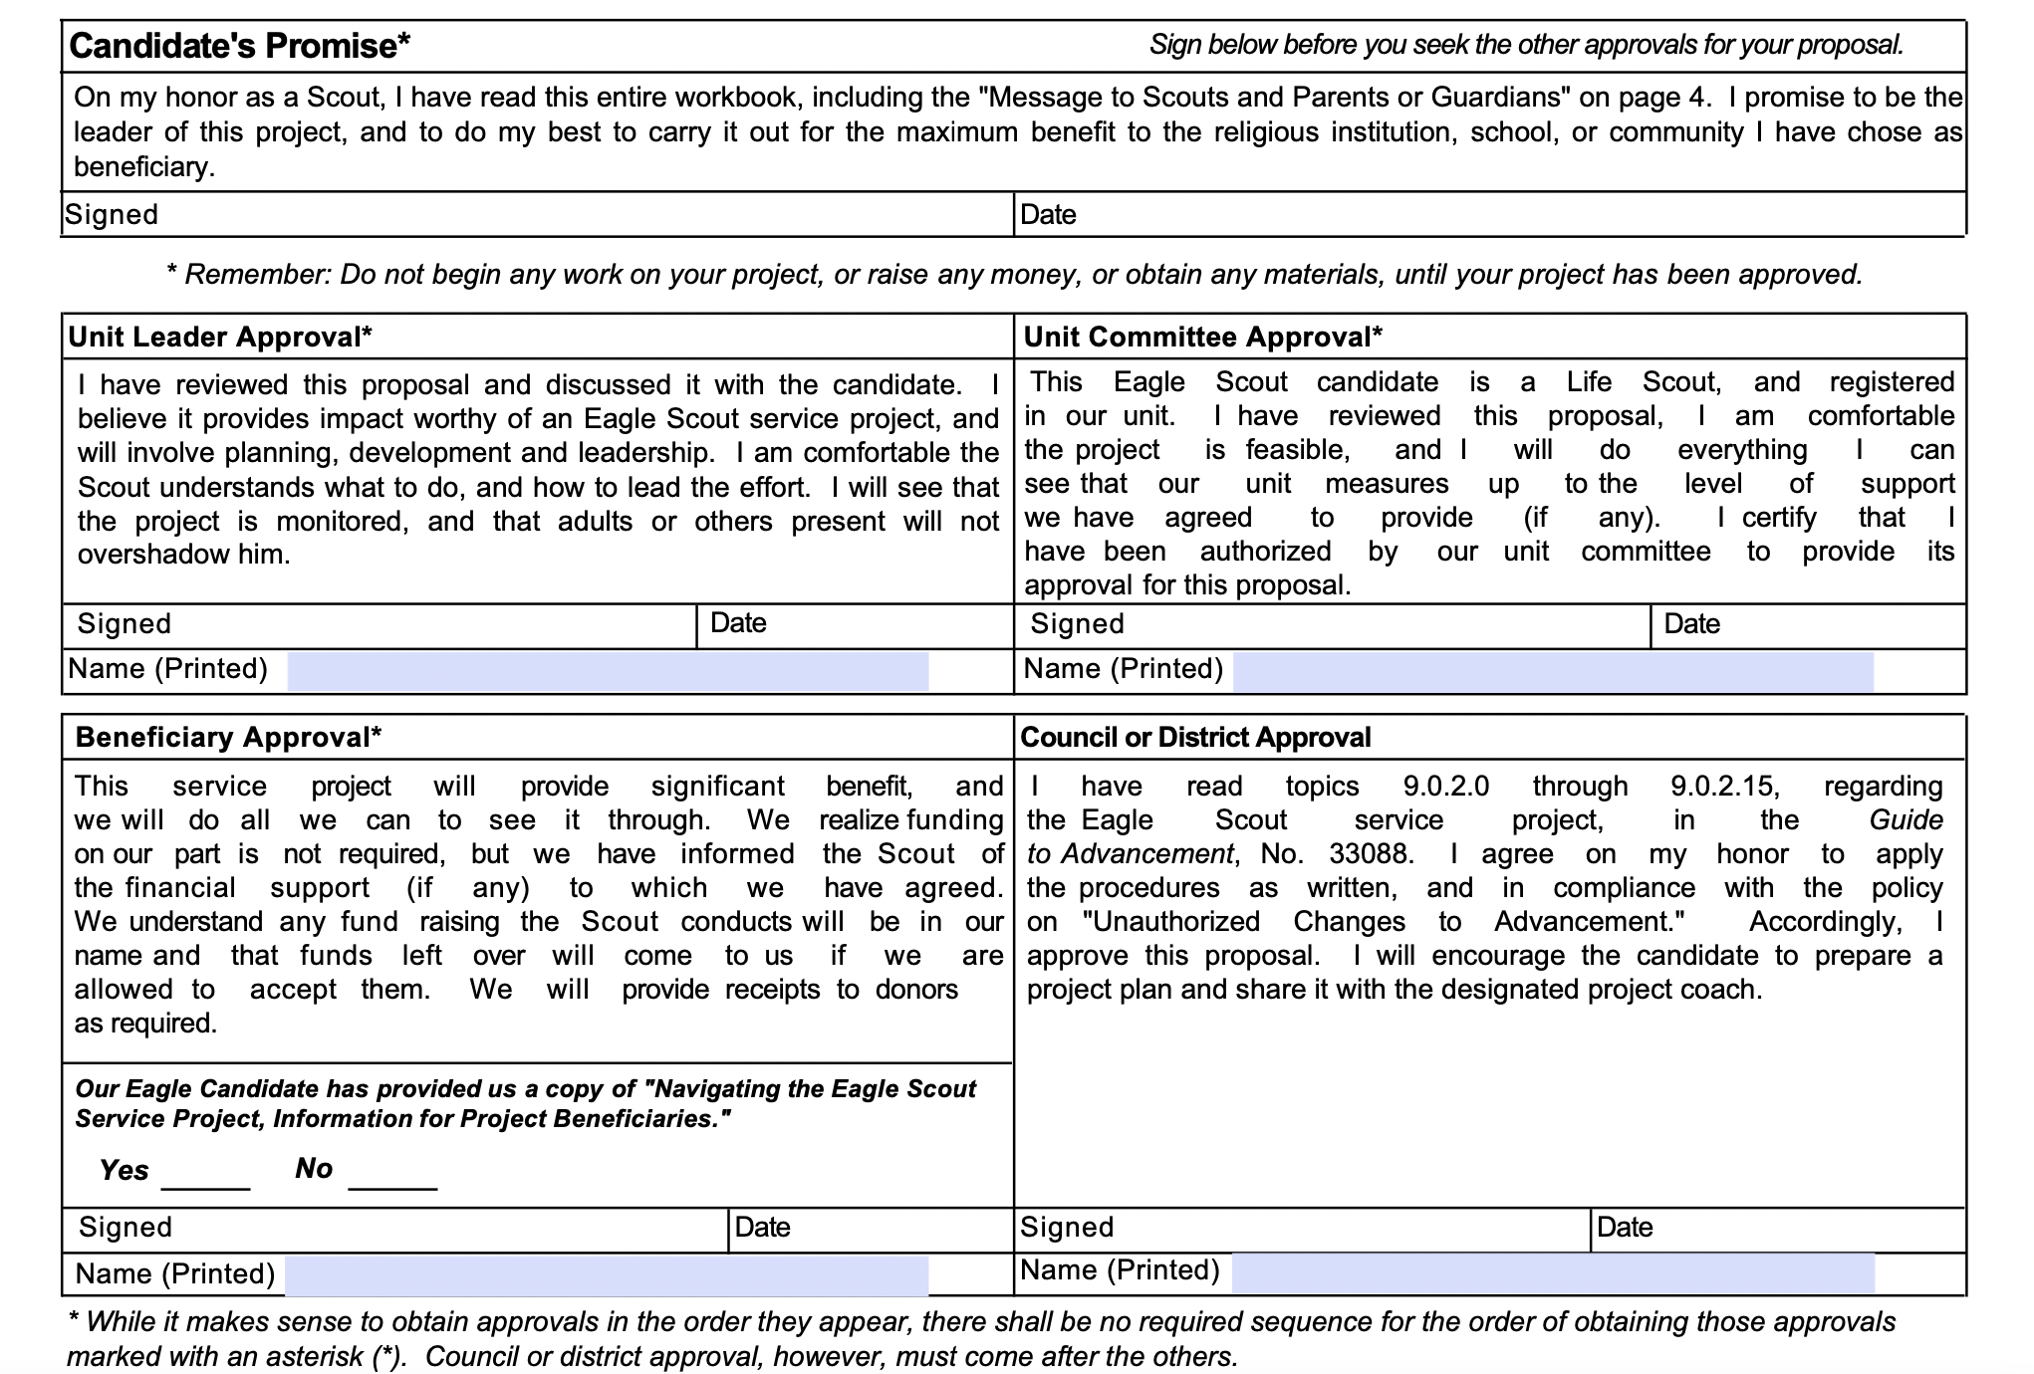
ESSP – Signature Page!
The signature page needs to have all signatures, but the district signature, before district approval sign off.
Make sure YOU sign!
Make sure Beneficiary signature and check box for “Navigating…. “ is complete!

Slide 35
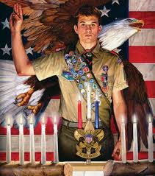
Intermission!

Slide 36
ESSP – How to Submit your Proposal
X
X
1) Send an email notice to the Iron Hill Eagle Board that you are ready to submit your Eagle proposal. Mr. White - 70Eagle279@gmail.com. (Note you should cc your SM and mentor. All emails require at least one additional adult to comply with Youth Protection Requirements!). Body of the email should be written using proper etiquette and include a brief introduction of the candidate
2) Mr. White will send you an invitation to setup a free cloud storage account on www.mega.nz This email will come from directly from mega.nz. (Your cloud account is free and will be yours to use even after your project is approved. However the access to your project folder will be deleted once the approval has been made.)
3) After you have setup your account you will need to accept Mr. White’s invitation to share your folder on the cloud server.
4) After you have accepted the invitation notify Mr. White and he will send you a link to your folder.
5) You will then be able to upload all the required documents necessary for the review and approval of your project.

Slide 37
ESSP – Required Proposal Documentation
X
X
Uploaded documents must include the following:
  One ORIGINAL ESSP Workbook pdf file (not a scan). This should be the newest version – 2023a downloaded from Scouting.org.
    Note: We will not accept the older versions due to software incompatibilities with certain versions!
  One scan of Signature page (proposal page E) with all signatures, except the one for District Approval.
    You need to provide a copy of “Navigating the Eagle Scout Service Project, Information for Project Beneficiaries.” and they need to check the block that they received it.
  Optional – Additional pages with photos, drawings, diagrams, illustrations, etc. of locations and items you may build for your project.

Slide 38
ESSP – District Advancement Committee Review/Approval
Eagle Board of Review Approves the Proposal
  Is the Community Benefit within guidelines?
  Is the Leadership Opportunity commensurate with the rank of Eagle?
  Does the candidate know how he or she will complete the detail plan?
  May/Often need more information to complete approval – allow 2-4 weeks for the entire process, duration usually depends on response times.
  You may be asked to make corrections or additions and resubmit before final approval is given.
  Approval is typically communicated by email & will include
  Official notice of approval
  Scan of signature sheet
  Recommendations for detail planning
  Directions for completing the Eagle Rank application process
  Keep a copy of this for your Eagle Application
X
X

Slide 39
ESSP – Items often overlooked in the proposal
  Contact sheet - empty boxes – all need to be filled in, including Scout ID (PID) and Life BOR date, beneficiary information…..
  If you are doing construction, landscaping, remodeling – please include diagrams, plans, and if outside, maps. Maps should show be close to scale and include buildings, roads, landmarks, etc. Use of marked up Googlemaps or similar are acceptable.
  Photos of the current location are helpful for the reviewers to better understand the state of the project area. Using a person as reference in a photo is helpful to gauge size, height and distance.
  If moving or removing material during the project, explain what you plan to do with it – dirt, grass, old structures – fence picnic tables, shed, etc.
  The signature page needs to have all signatures, but the district signature, before district approval sign off.
X
X

Slide 40
ESSP – District Advancement Committee Review/Approval
X
X
A virtual call on Zoom will be setup with a member of the Eagle Project Board within a week of approval to answer questions and go over:
  Responsibilities of the Coach, Troop and Parents in the project.
  Finishing the final detailed plan and submitting fundraising application
  Changes in the project – Major vs. minor.
  Managing the beneficiary – Project Creep
  Communication between all parties.
  Keeping records –
    spending & managing funds
    Volunteer sign-in sheets. Each day should have a volunteer sign in sheet with the time each person started and stopped for the day. This will make it easier to calculate the hours.
    Each work day the scout should write-up the days events and what went right and what they could improve on (Thorns and Roses)
    Photos
  Paper work you should consider for your final report and Eagle Application

Slide 41
ESSP – Final Plan
ESSPW – Final Plan pages A to E
X
X
Responsibility for completing the “Eagle Scout Service Project Plan” (Detail Plan) section of the workbook
  The Eagle Candidate is responsible for completing the Project Workbook.
  The Unit Committee & Mentor is responsible for guiding and supporting the candidate (safety, quality, technical aspects).
  Timing of completing the Detail Plan
    Can start anytime but don’t put too much effort in prior to approval.
  Is to be complete BEFORE starting work on the project.
  Once complete, or nearly complete, share the plan with the approvers for any final input they may have.
  It is not necessary to resubmit to the Eagle Board for final plan approval.

Slide 42
ESSP – Fundraising Application
ESSPW – Fundraising Application pages A to B
X
X
  Fundraising application
  All fundraising activities require Council Approval. Submit your fundraising plan to the registrar, (Mrs. Carol Swank) as soon as you district approval. (Suggest this be signed by beneficiary at the same time the project proposal is signed).
  The fundraising application is not necessary for contributions from the candidate, the candidate's parents or relatives, unit or its chartered organization, unit's parents or members, or the beneficiary. All proceeds left over from fundraising or donations, whether money, materials, supplies, etc., regardless of the source, go to the beneficiary. However a fundraising application is required for discounts, donated materials, supplies etc.
  Make sure to consider whether your fundraising project will be a major portion of the demonstration of your leadership And - Please reference the back of the fundraiser application Page 24 of the ESSP.

Slide 43

ESSP - Finishing the Job
Execute the Plan & Complete the ESSP workbook
YOU lead others to accomplish the project goals
YOU are responsible for safe working conditions
YOU track work progress, hours worked, money spent, etc.
YOU develop solutions to unforeseen challenges
YOU record changes made to the plan including
  why the change was made
  how the solution was decided
Record worker hours – Including Fundraising
Obtain final signatures from the
  Unit Leader, Unit Committee, and Beneficiary
Thank all of those people, groups or businesses that made your project successful. Should include photos of completed projects.

Slide 44
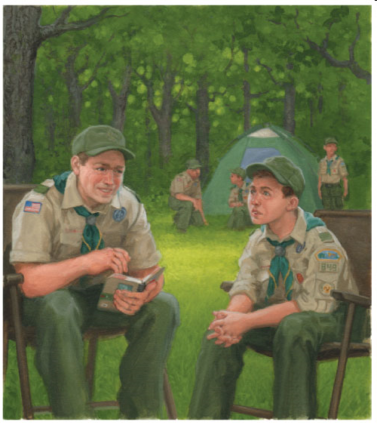
Requirement 6. ULC
Take part in a unit leader conference.
Attach to the Eagle application a statement of your ambitions and life purpose* and a listing of positions held in your school, camp, community, or other organizations during which you demonstrated leadership skills. Including honors & awards received during this service. Check spelling & Grammar. You may want to have someone proof read before submitting.
This is the final opportunity for the Unit Leader to review and “test” YOUR readiness for the Rank of Eagle
It must be completed prior to YOUR 18th birthday
Requirement 7. Successfully Complete an Eagle Board of Review

Slide 45
Requirement 6. Statement of Life Ambitions and Goals
Your Statement of Life Ambitions and Goals is your opportunity to tell the Eagle Board what you view as your goals for the future! This is what you plan to do once you age out of being a Scout. This may include if you plan to seek higher education, attend trade school, go into the military, pursue public service, etc. It may include how you see or plan to see your life in the next 5, 10, or more years.
Your statement may also include what you see yourself doing for a career, a family, community activities, travel…..
Although you may include your background in Scouting and how it has prepared you for your future, it is not a look back on your past and all the things you did as a Scout, but a vision of how you see your future and what you intend to do to make it happen!

Slide 46
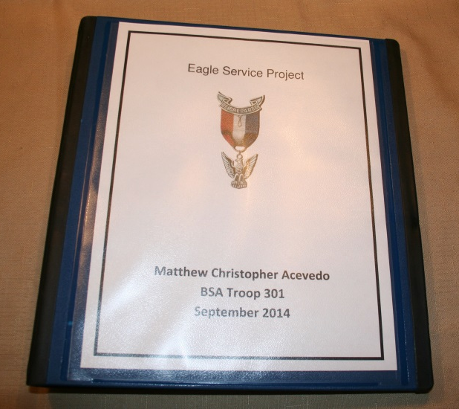
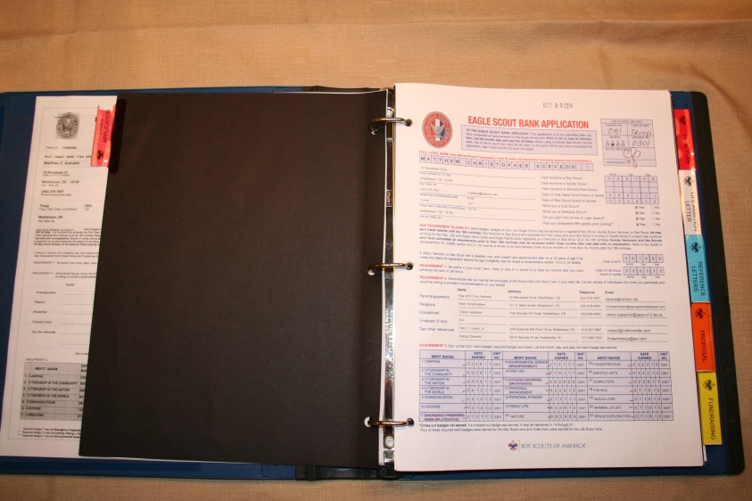
Eagle Rank
Application Process
Complete Application requirements 1-5. (Note this includes references supplied by persons in requirement #2!)
Assemble Eagle Rank Application (This is the 21st century – use a computer. No hand written applications!)
Complete the Unit Leader Conference
Obtain final unit signatures on the application
Submit a copy to the Council Registrar via email.
  Make one print copy of application packet. Make it look professional – be PROUD of it.
  Pages numbered, bound, not in page protectors and no staples (Iron Hill)

Slide 47
Eagle Rank
Application Process
Your Application should include:
  The Eagle Rank Application - checked for errors
  Copies of the Individual Progress, Individual History, and the Individual Participation reports from TroopMaster, or Scoutbook.
  Your project approval email you received from the district allowing you to proceed. Also, include all additional communications you may have received from the District committee.
  The complete Eagle Scout Leadership Service Project (ESLSP) with required signatures. Extra pictures, receipts, flyers, thank you letters, and planning documents that you used can and should also be included
  Your Statement of Life Ambitions and Goals and Extra-Scouting Leadership and Honors

Slide 48
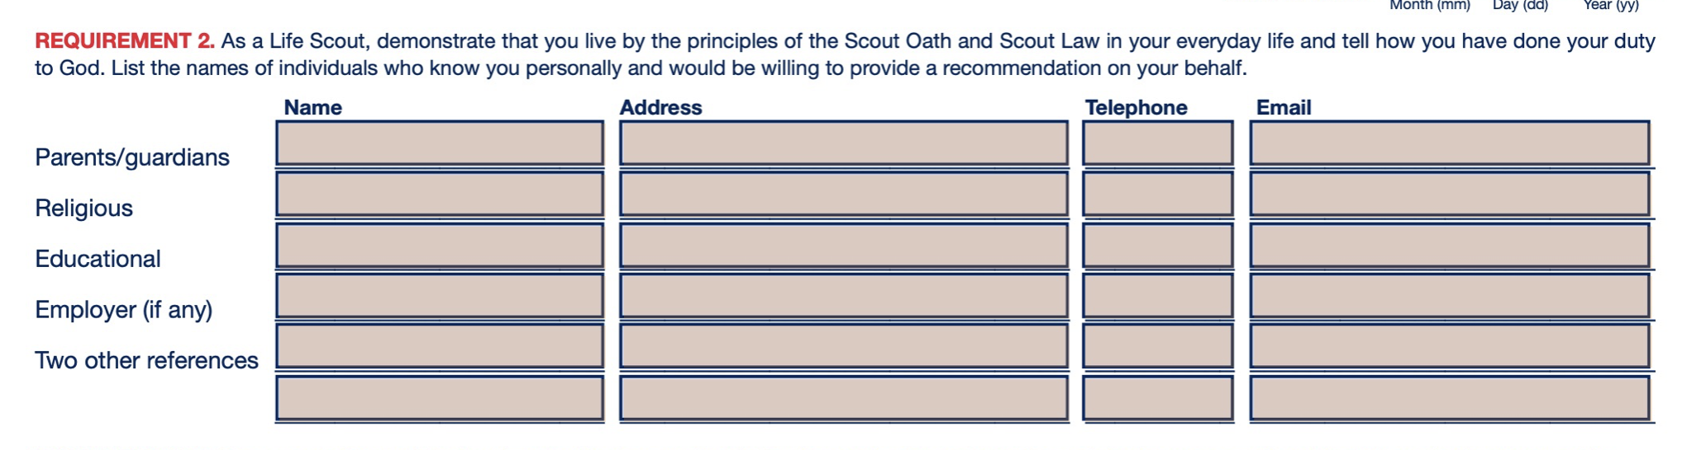
Eagle Rank
Application Process
Written reference letters are to be submitted separately by your Scoutmaster or Advancement Chair. From a list you have provided to them.
Reference letters should match the list on the Eagle Application, e.g. the reference you put in line #2 should be a religious reference, etc.
If the required references are not included Mrs. Swank will return the application for revision.

Slide 49
Eagle Rank
Application Process
Registrar validates application, confirms that all information is included and notifies Eagle Board Chair to schedule the Eagle Board of Review.
Eagle Board is scheduled with the Candidate by the Eagle Board Chair
Conduct Board of Review (Board make-up may vary between Districts).
Make sure to look your best for your Eagle PRB!
  Wear your sash with all merit badges
  You should have all current rank and other patches on your uniform.
  Wear any Scout awards, medals, knots, etc.
  Bring your Scoutbook to be signed by the EPRB members (N/A for Zoom PRBs)
Council Scout Executive Approval.
National approval.
Award materials are available 4-6 weeks after Eagle Board of Review is complete.
Troop/Crew Conducts Eagle Court of Honor.

Slide 50
What to expect in your Eagle Board of Review
Once your application is reviewed by council your Eagle Board will be scheduled.
The Board will last approximately 45 minutes to 1 hour. This will be an in-person board. Zoom is optional but not recommended unless the Scout cannot attend at the designated location.
The board will consists of approximately 3 - 4 adult Scouters from Iron Hill district, but not from your unit, a member of your troop committee. Your Scoutmaster will also be in attendance, he/she is there to only act as your advocate and for support, but will not be able to ask you any questions. No other individuals will be allowed to attend the board session until a decision on your application is made.
During your board you will be ask a number of questions of which there is no right or wrong answer. Some will be questions of your Scouting history, some will be about your thoughts of the Scouting program, The Scout Law, Scout Oath, etc., and there will be questions about your project.
Following the question and answer period the board will meet without you or your Scoutmaster and will decide if you passed your board. The decision must be unanimous.

Slide 51
Examples of Board Questions
There are no right or wrong answers, but simple yes and no answers are rarely sufficient.
Tell us what merit badge you learned the most?
What was your favorite experience in your Troop?
What is your style of leadership?
What is your favorite meal to cook on a campout, and why?
What would you change about the Scouting program if you could?
How do you deal with leading Scouts that are older than you, younger than you?
What does ”Duty to God” mean to you?
  (hint - it does not mean you go to church every week, nor does just saying living the Scout oath and Law count as a sufficient answer)

Slide 52
Eagle Rank Resources
Website URL – Subject to Change
Eagle Scout Service Project Workbook and Procedures. NEW for 2023
http://www.scouting.org/scoutsource/BoyScouts/AdvancementandAwards/EagleWorkbookProcedures.aspx
Eagle Application (PDF). (2022 rev.)
http://www.scouting.org/filestore/pdf/512-728_WB_fillable.pdf
Guide to Safe Scouting. http://www.scouting.org/scoutsource/HealthandSafety/GSS.aspx
Guide to Advancement. New for 2021 http://www.scouting.org/scoutsource/GuideToAdvancement.aspx
Age Guidelines for Tool Use and Work at Elevations or Excavations.
http://www.scouting.org/filestore/healthsafety/pdf/680-028.pdf

Slide 53
Extension Requests
If a Scout foresees that due to no fault or choice of his or her own, it will be impossible to complete the Eagle Scout rank requirements before age 18 may apply to the local council for a limited time extension. These should be granted only when necessary and are reserved only for work on Eagle. In most cases, unless the National Council has issued other direction, a request must meet the three tests listed below to be approved.
  Test #1: The member joined or rejoined (or became active again after a period of inactivity, or became refocused on advancement after a period of inattention) in time to complete all requirements before turning 18.
  Test #2: Through no fault or choice of the Scout, an unforeseen circumstance or life changing event with severe consequences has come to exist that now precludes completion of the requirements before the deadline.
  Test #3: The circumstance is beyond the control of the Scout, could not have been anticipated or planned for, and was not or cannot be resolved in time to complete the requirements.
Extensions are never guaranteed! Extensions are only approved in emergency circumstances as noted above. DO NOT RELY on an EXTENSION!

Slide 54
Discussion
&
Questions

